Slide 1
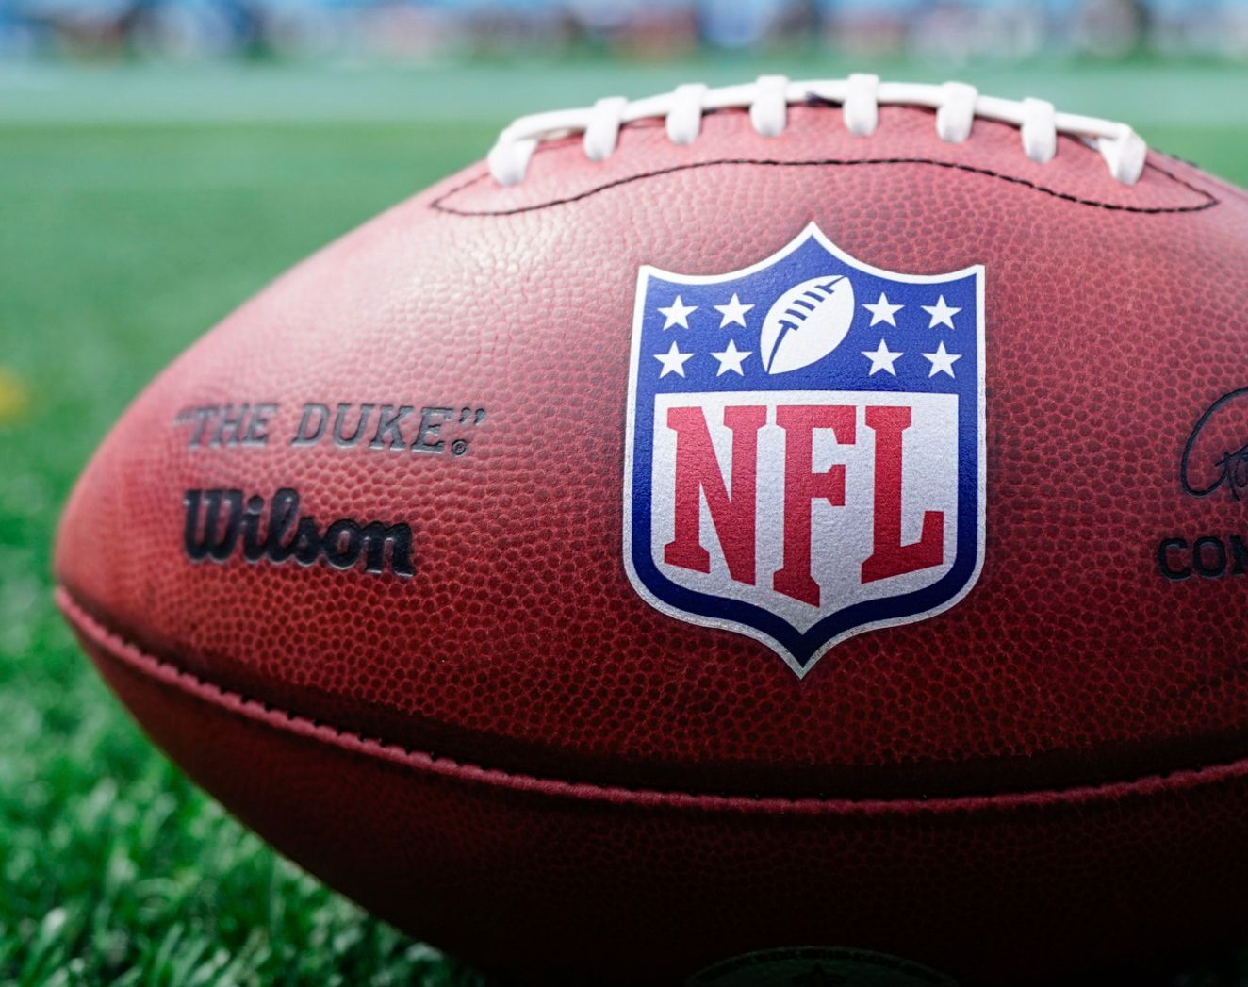
Success Through Sports Analytics: Analyzing Yards, Turnovers, and Winning Trends

Slide 2

Introduction
About the Project / Dataset:
This project will analyze data from 672 NFL teams spanning 21 seasons to uncover trends and factors that contribute to team success. The dataset includes a wide range of statistics, such as team records, passing and rushing metrics, penalties, turnovers, and other performance indicators.
Methodologies Used
Data Loading
Data Cleaning
Data Analysis Using Descriptive Analysis
Data Visualization
Data Aggregation

Slide 3
Problem / Goal
1 ) Do Teams with Higher Total Yards Per Game Correlate with More Wins?
2 ) Are Turnovers ( Fumbles , Interceptions ) Negatively Correlated With a Team’s Win Percentage?
Data Used:
https://github.com/OpenDataO/NFL-Team-Data-2003-2023

Slide 4

The Plan Techniques Utilized
1 ) Import the Necessary Data and Packages
- Load The CSV File
2 ) Clean the Data
- Handle Missing Values, Filter Key Variables and Standardize Column Data Types
3 ) Use the Pandas Package
- Summarize the Data with Descriptive Statistics
4) Identify Teams With Most and Least Wins
5) Identify Teams With Most and Least Total Yards
6) Create Visualizations
- Generate Scatterplots and Bar Charts to Illustrate Findings
7) Draw Conclusions

Slide 5

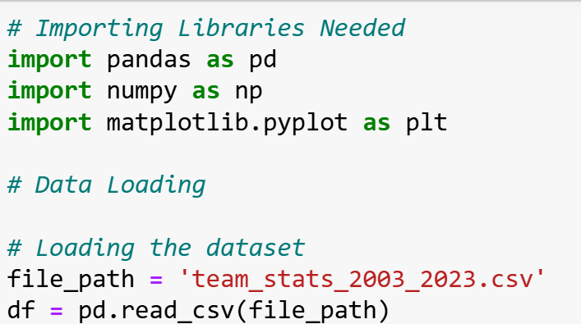
Step 1: Importing Data and Packages
Pandas library will be used for data manipulation, cleaning and analysis
NumPy library will be used for numerical computations, handling arrays and supporting data manipulation
MatPlotLib library will be used for creating visualizations

Slide 6
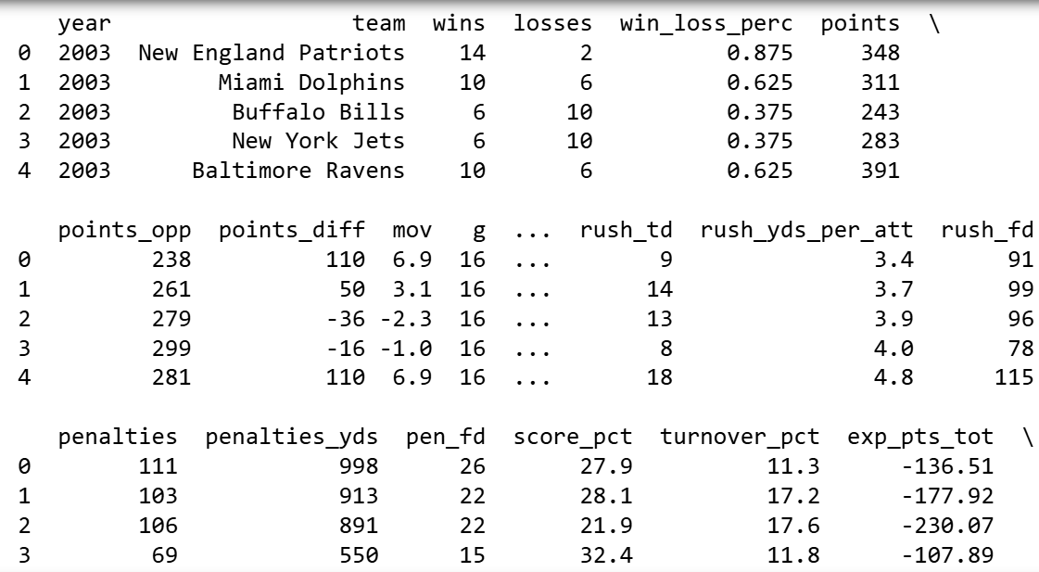

Step 1: Importing Data and Packages
Sneak peak inside the dataset we’re using

Slide 7

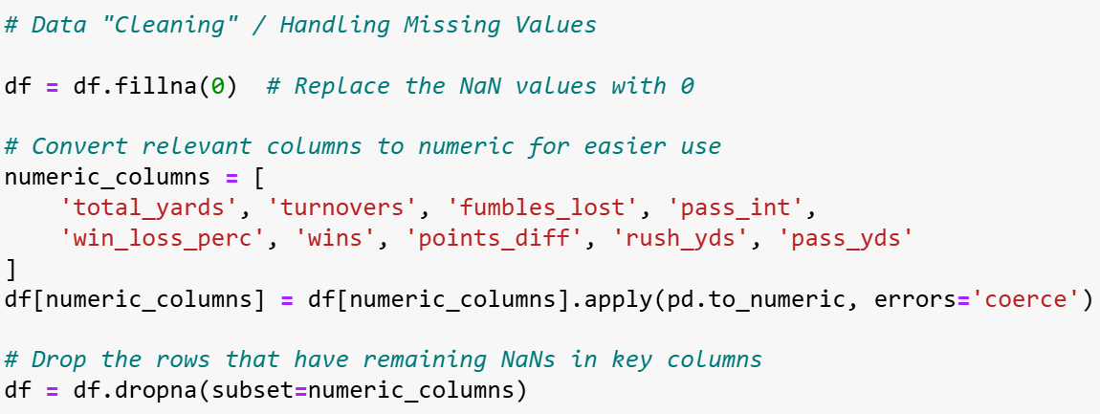
Step 2: Cleaning Data
Fill Missing Values in the Dataset With Zeros
Convert the relevant columns to numeric for easier access / use
Ensure ONLY Specific Key Columns are Free of NaN Values

Slide 8

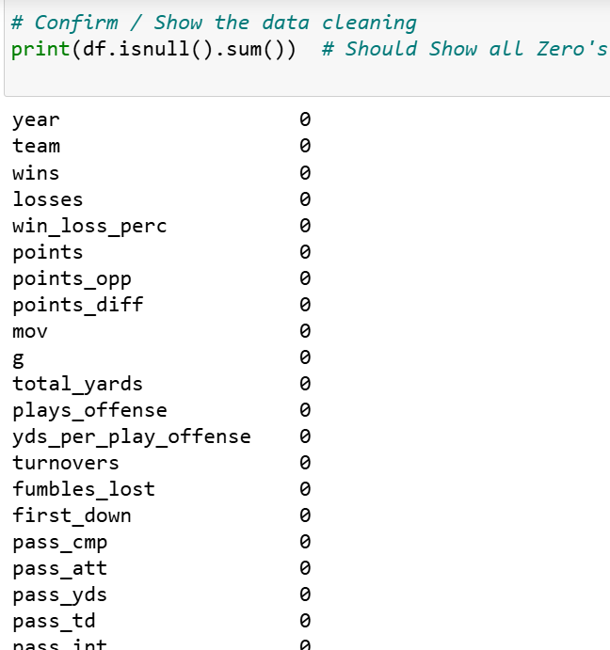
Step 2: Cleaning Data
After Doing our Data Cleaning From the Last Slide, We Can Check if We Did it Correctly.
We use “isnull().sum() for our Clean DataFrame.
It Should Return 0 For All of Our Key Columns, Replacing All NaN Values.

Slide 9

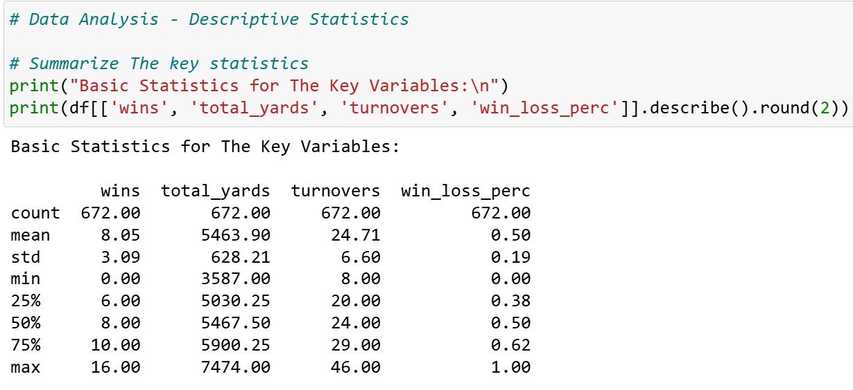
Step 3: Basic Statistical Observations
This is Some Basic Data Analysis using the Pandas library that shows the median, min etc.. for each variable in the Data Frame
For Example, We Can See That the Average Wins Per Season for a Team is 8.05

Slide 10

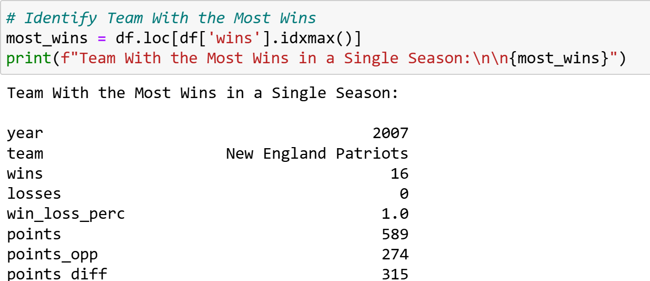
Step 4: Finding Team with the Most Wins
We Use the “ idxmax” Function in pandas to Find the Team With the Most Wins
From our Results, we See that the New England Patriots are the Team With the Most Wins
16 Wins and 0 Loses ( 100% Win Rate )

Slide 11
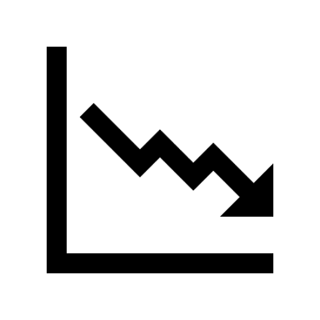
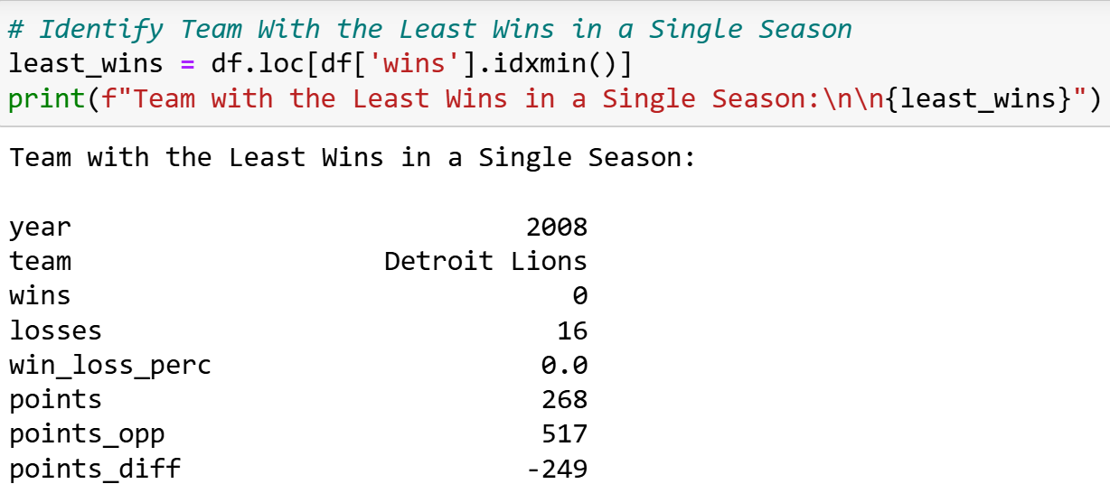
Step 4: Finding Team with the Most Losses
We Use the “ idxmin” Function in pandas to Find the Team With the Most Losses
From our Results, we See that the Detroit Lions are the Team With the Most Losses
0 Wins and 16 Loses ( 100% Loss Rate )

Slide 12
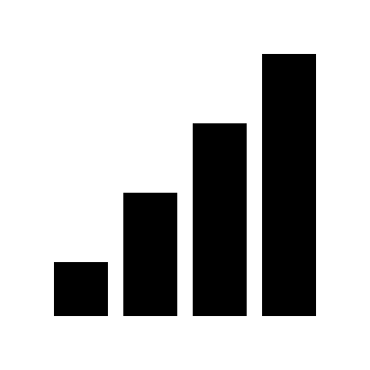
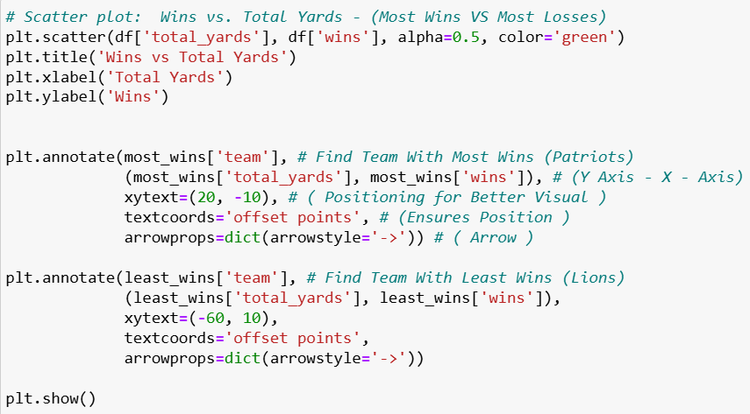
Data Visualization
Scatter Plot that will visualize the relationship between Total Yards and Wins for all teams
We Highlight the team with the most wins ( Patriots ) and the least wins ( Lions )
Used arrows to point to specific data points for better visual.

Slide 13

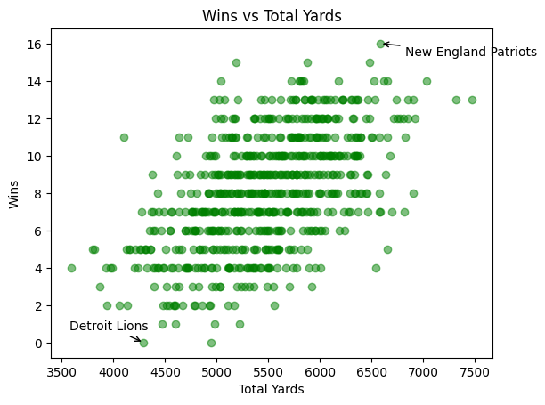
Scatter Plot:
Visualizes Relationship between Total Yards and Wins for ALL teams
Teams With Most and Least Wins

Slide 14
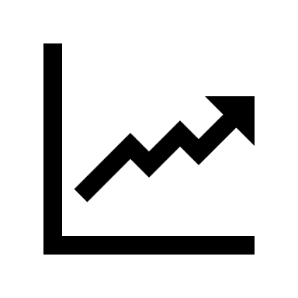
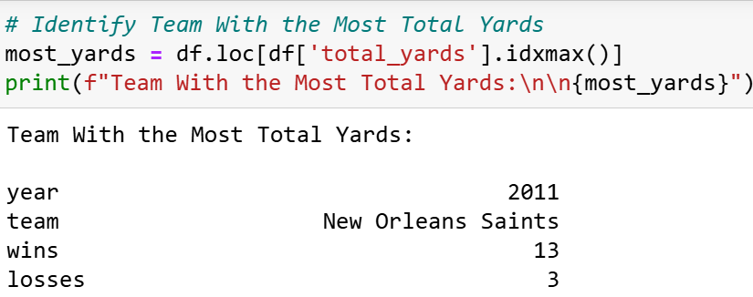
Step 5: Finding Team with the Most Yards
We Use the “ idxmax” Function in pandas to Find the Team With the Most Total Yards
From our Results, we See that the New Orleans Saints are the Team With the Most Total Yards
7474 Total Yards in One Season ( Averaging 464 Yards Per Game )

Slide 15
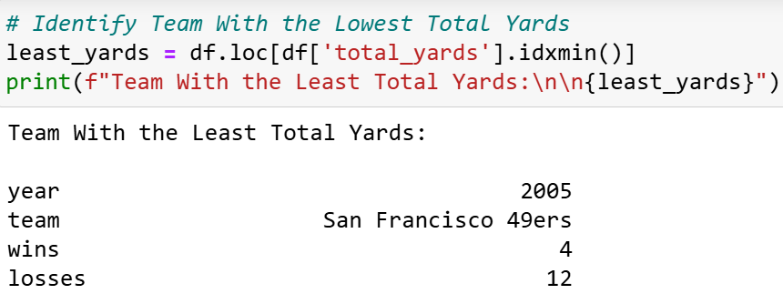
Step 5: Finding Team with the Lowest Yards
We Use the “ idxmin” Function in pandas to Find the Team With the Lowest Total Yards
From our Results, we See that the San Francisco 49ers are the Team With the Lowest Total Yards
3587 Total Yards in One Season ( Averaging 224 Yards Per Game )

Slide 16
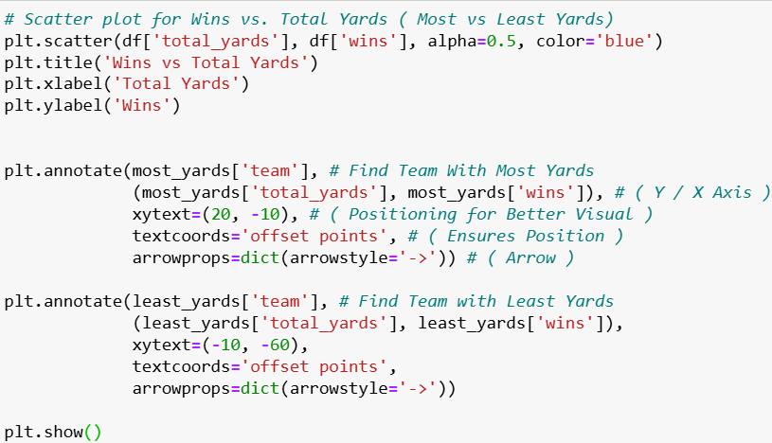
Data Visualization
Scatter Plot that will visualize the relationship between Total Yards and Wins for all teams
We Highlight the team with the most yards ( Saints ) and the least yards ( 49ers )
Used arrows to point to specific data points for better visual.

Slide 17

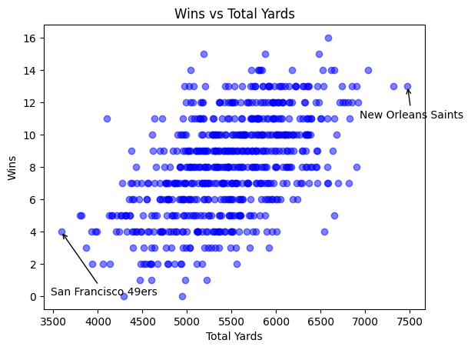
Scatter Plot:
Visualizes Relationship between Total Yards and Wins for ALL teams
Teams With Most and Least Yards

Slide 18
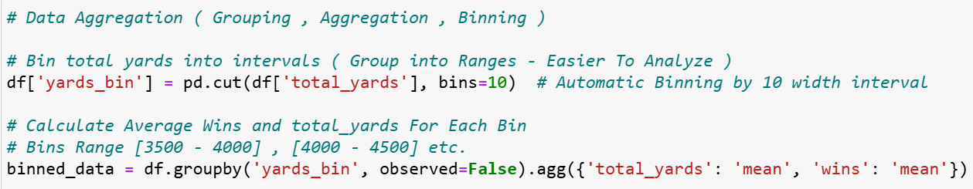
Step 6: Data Aggregation / Visualization
We use the Binning Technique From pandas Library For Easier Grouping and Better Visualization
A Team’s Total Yards After a Full Season could be Anywhere in the range of 3500 – 7000+ yards.
We used Automatic Binning with 10 width interval and the range being [3500 – 4000 ] etc…
“binned_data” is used to calculate aggregated statistics like the average.

Slide 19
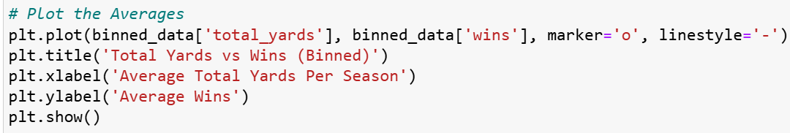
Step 6: Data Aggregation / Visualization
Created a Line Graph of the Average Total Yards Per Season ( Binned ) and the Average Wins Per Season
Yards ( X – Axis )
Wins ( Y – Axis )

Slide 20

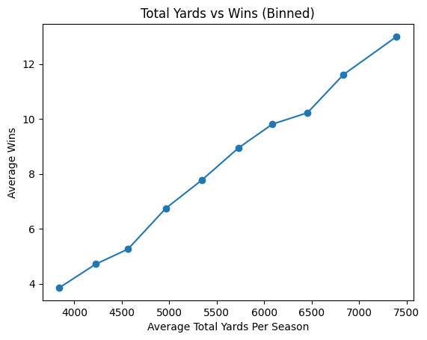
Line Graph:
Shows the Average Total Yards and Average Wins
Bar Chart Showing Average Price per Car Make

Slide 21
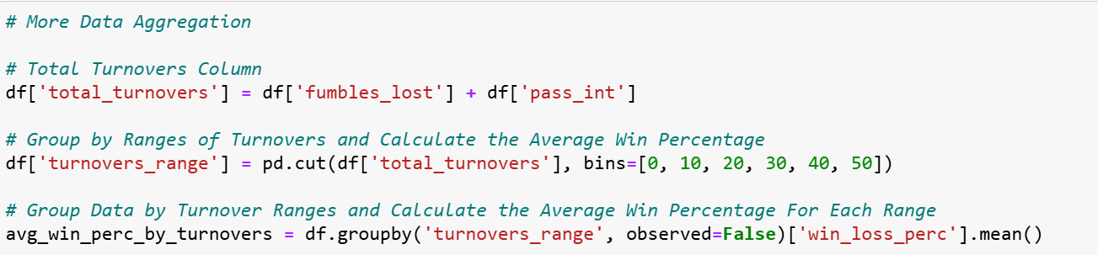
More Data Aggregation / Visualization
Created a new DataFrame for Total Turnovers ( Both Fumbles and Interceptions )
Used Manual Binning Technique to Range from 0 – 50 [ 0 – 10 ] , [ 10 – 20 ] etc…
Avg_win_perc is used to calculate average win percentage for each range / bin.

Slide 22
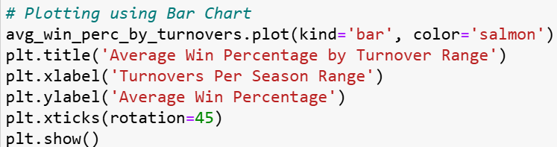
More Data Aggregation / Visualization
Created a Bar Chart of the Average Win Percentage and the Turnovers Per Season ( Binned )
Turnovers Per Season ( X – Axis )
Average Win Percentage ( Y – Axis )

Slide 23

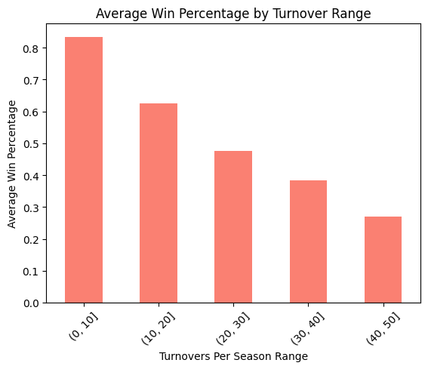
Bar Chart:
Shows the Average Win Percentage and Turnovers Per Season

Slide 24
Conclusion
Our findings suggest a positive correlation between total yards per game and the number of wins. Teams that gain more total yards tend to win more games.
There is also a negative correlation between turnovers (fumbles and interceptions) and win percentage. Teams with fewer turnovers are more likely to achieve higher win percentages.
It's important to note that while there is a clear correlation between total yards and wins, as well as turnovers and win percentage, this relationship is not consistently significant in all cases. Factors such as defense, special teams, and game-specific situations do not directly affect total yards but can significantly influence game outcomes, contributing to variations in these correlations.

